Slide 1
Surface Design: Printing
What is printing?
Printing is the application of an insoluble, coloured substance that is applied to the surface of fabric to apply colour and interesting design.

Slide 2
Methods of Printing
Direct Printing
Roller Printing
Block Printing
Warp Printing
Resist Printing
Heat Transfer
Notes:
Note: you can add between 3 and 6 sections, the structure can vary. The numbers have to be kept

Slide 3
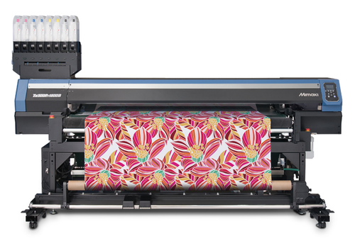
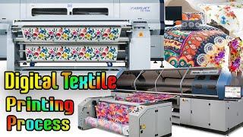
Direct Digital Printing
Digital Direct Printing is a process where bolts of fabric are fed through an ink-jet printing machines to apply a digitally designed pattern onto fabric using dyes.

Slide 4
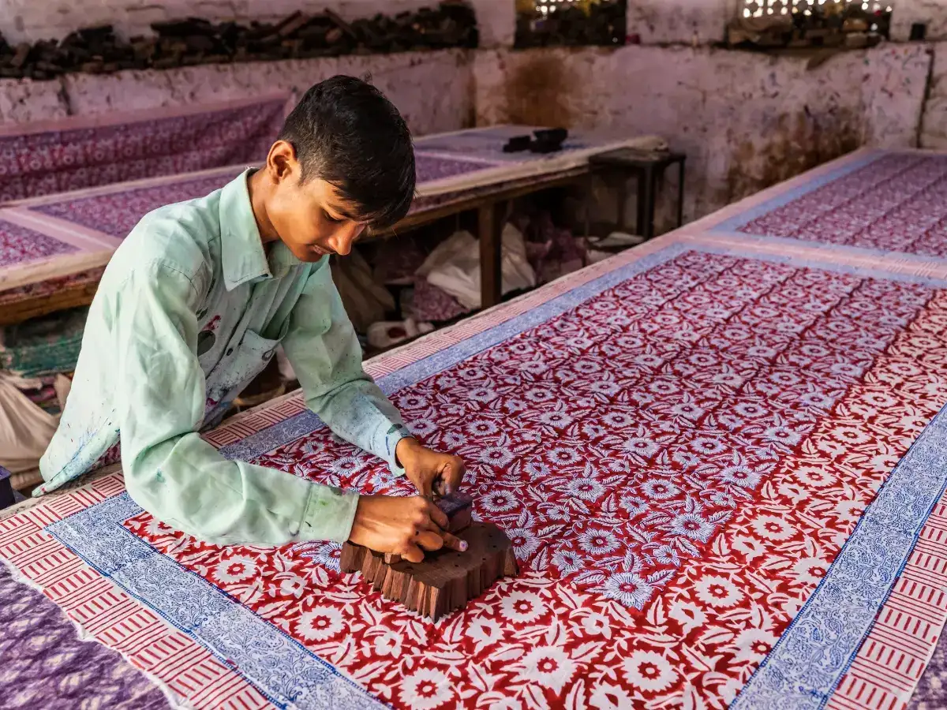
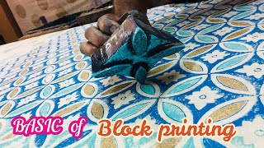
Block Printing
Block printing is the process of printing patterns by means of engraved blocks, typically made of wood.
Block Printing is a technique used widely across parts of East and South Asia

Slide 5
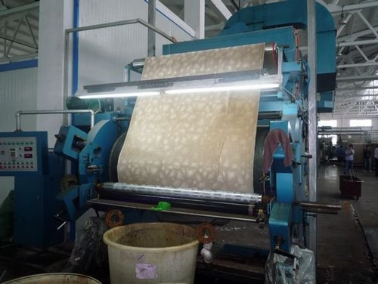
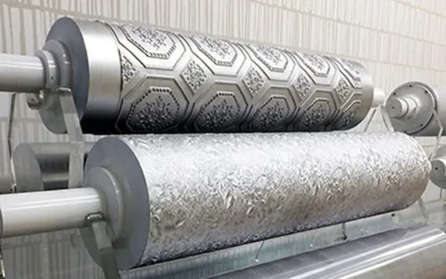
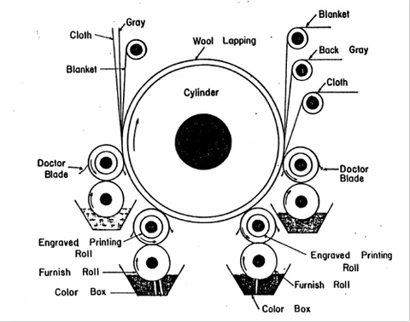
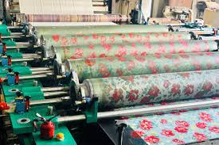
Roller Printing
Roller printing is a technique that involves engraved metal rollers to apply designs onto the surface of fabric

Slide 6
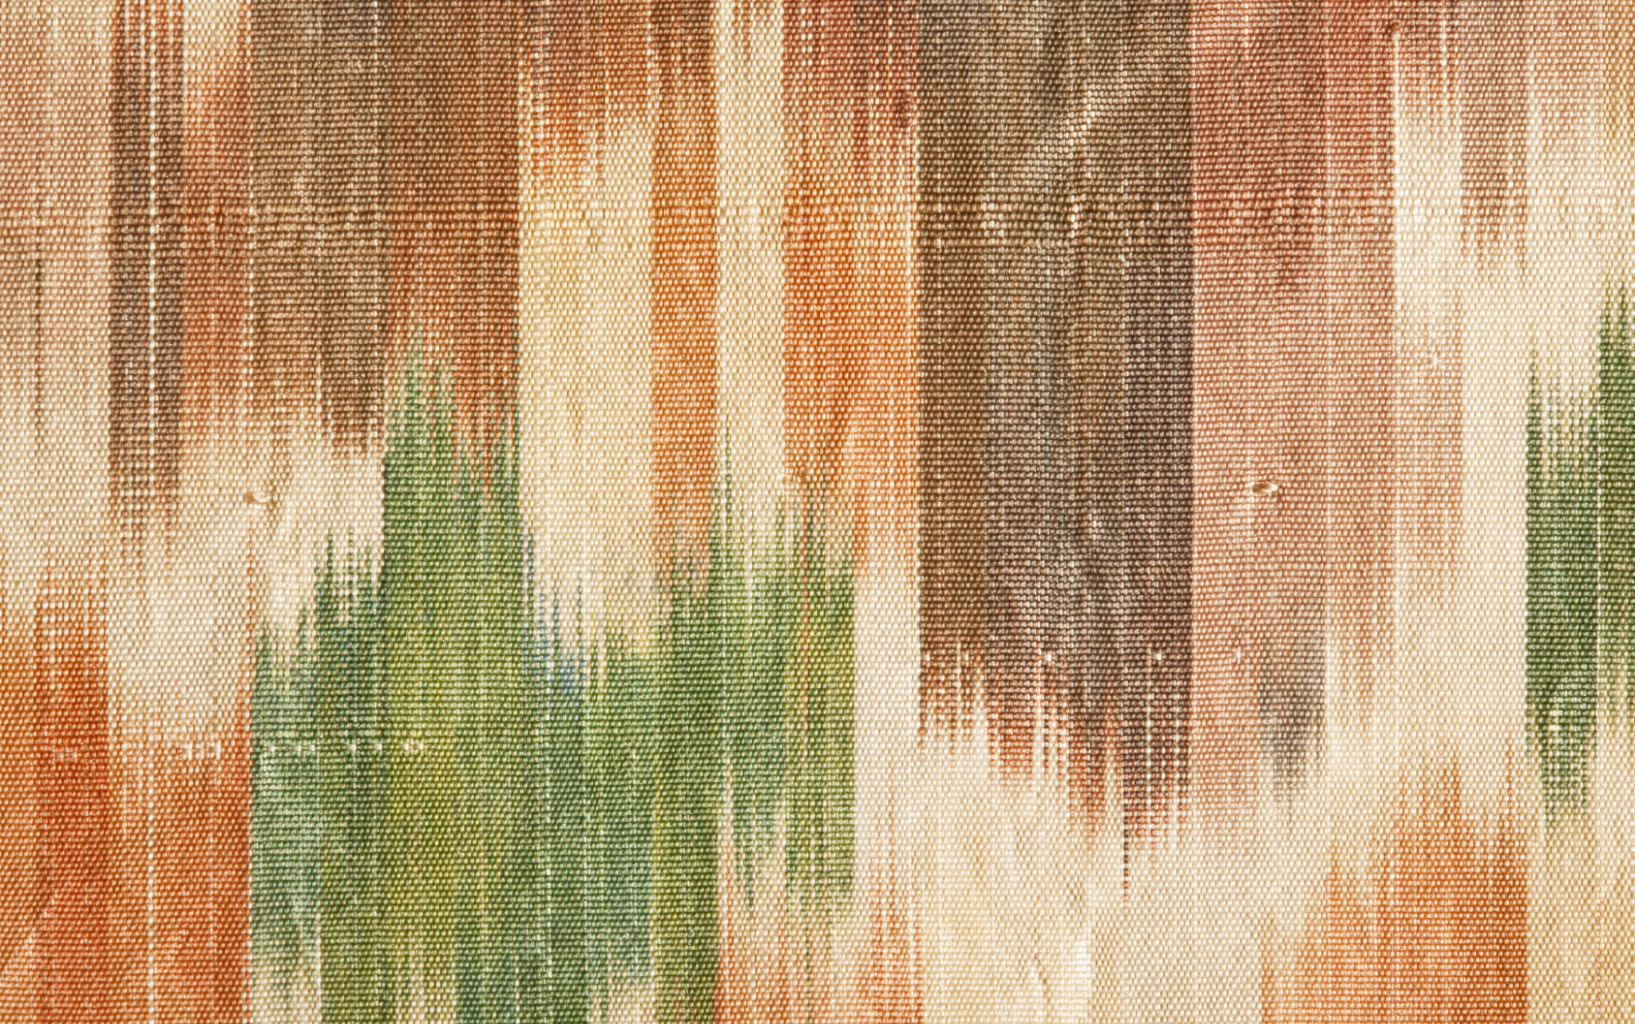
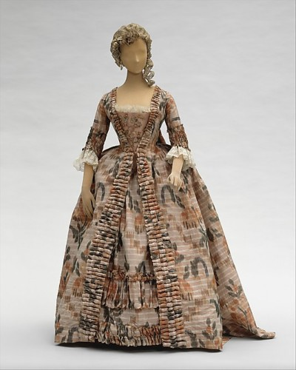

Warp Printing
Warp printing combines weaving and printing techniques, by printing only the warp yarns of a fabric, typically silk, to create a blurred and vague pattern.
This method of printing was particularly fashionable for summer wear during the 18th century.

Slide 7
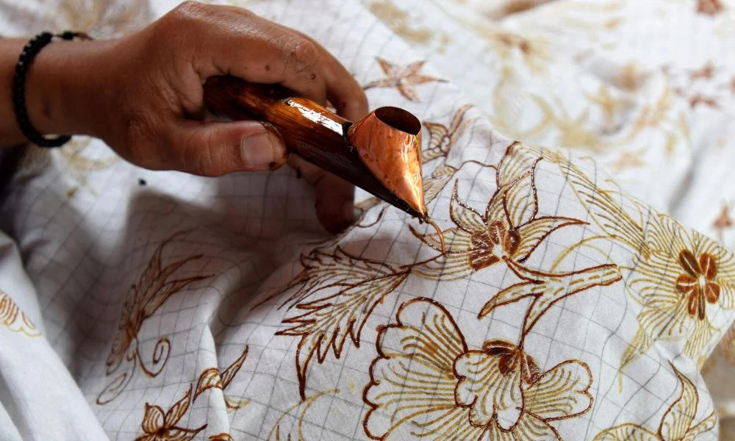
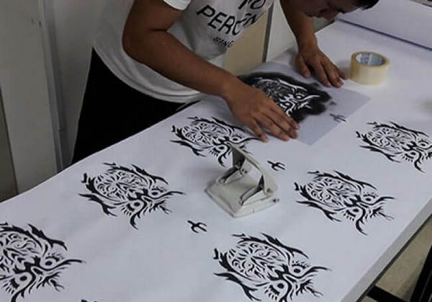
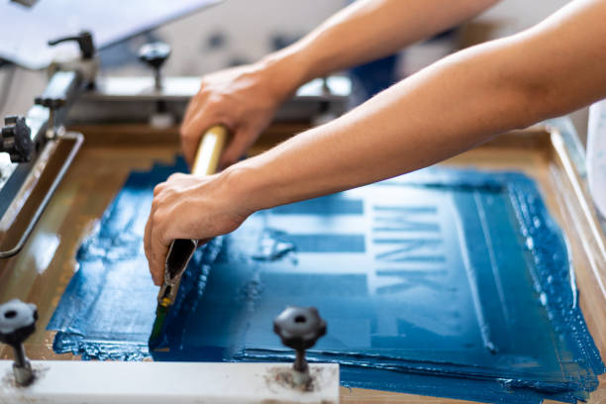
Resist Printing
Resist printing is a method of colouring fibres in a pattern by pretreating a designed area to resist dyes from penetrating the surface of the yarns.
Examples of resist printing include;
Batik
Stencil printing
Screen printing
Machine or flat-bed printing
Rotary screen printing

Slide 8
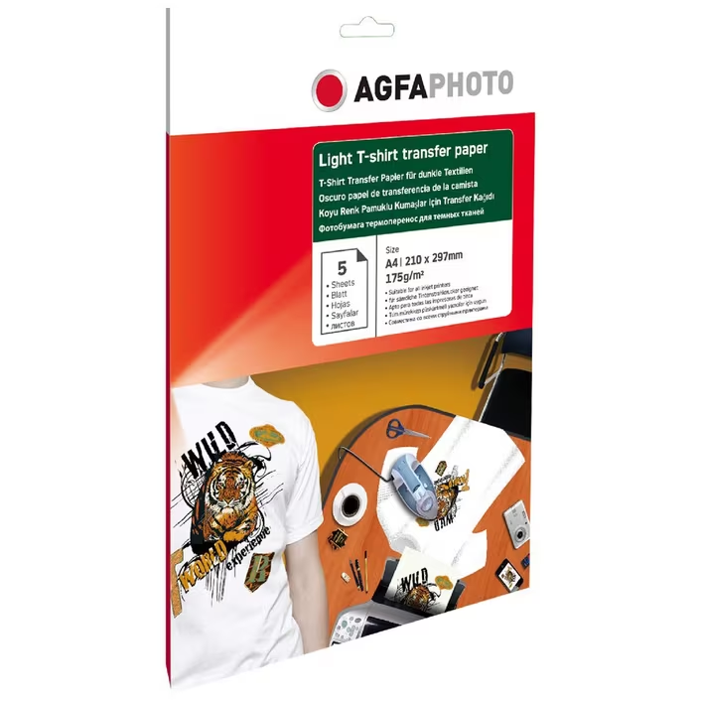
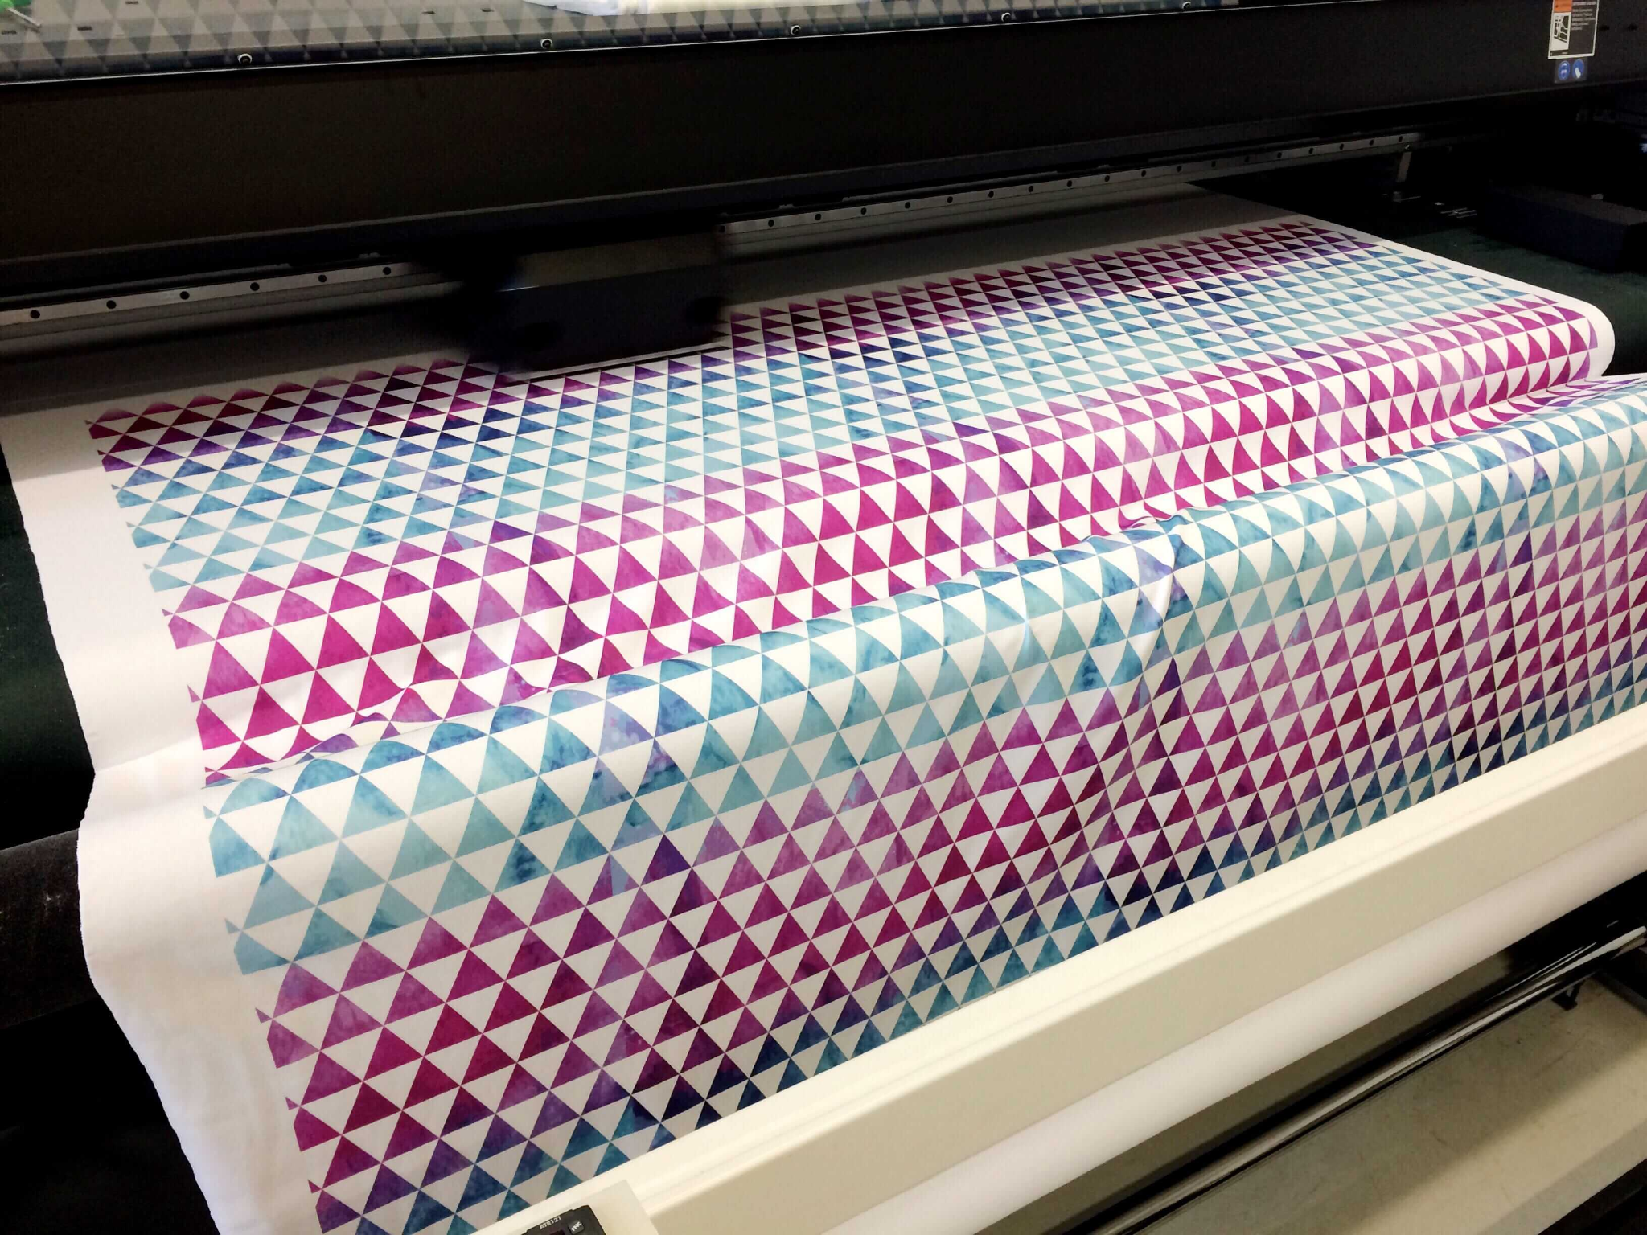
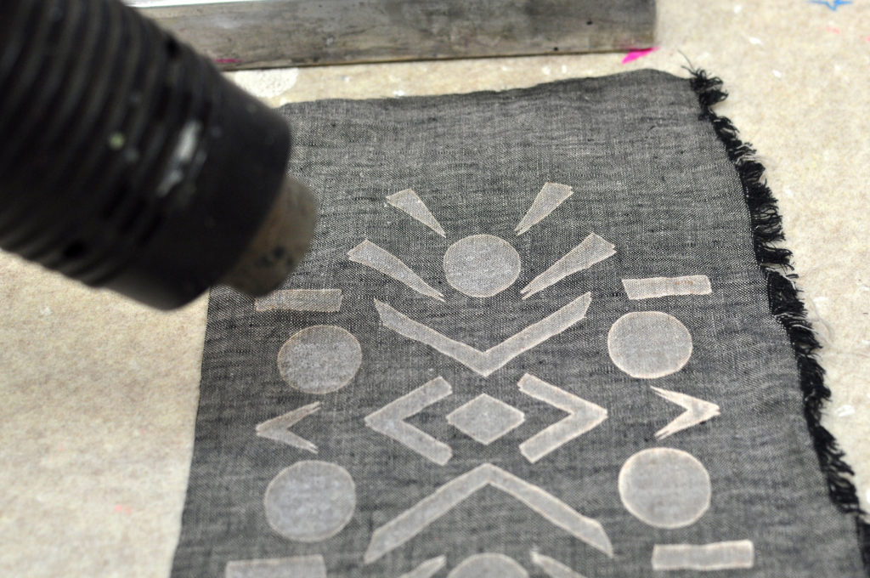
Heat Transfer Printing
This technique involves disperse dyes that transfer from paper to fabric with heat. The cloth fibres open with heat allowing the dyes to bond permanently. The process is simple and allows the designer to create multi-coloured designs.
Notes:
El gráfico de tiene que estar hecho por Google Sheets. Hay que incluir una leyenda para que el usuario pueda incluir información de la gráfica

Slide 9
Illustrator Trace Tool
This tool will be used for today's activity, where you will create your own print design.

Slide 10
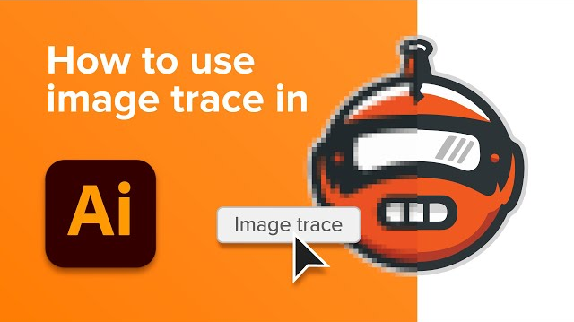
Watch this video
How to use Image Trace Tool in Illustrator
Watch the following video, then using the instructions on the instructions sheet to start developing your own print designs. This can follow any printing method outlined previously in this presentation.
https://www.youtube.com/watch?v=AUxtDCyaPFg

Slide 11
Evaluating Your Designs
Write a brief PMI of your design, using the elements and principles of design alongside your inspirations for the design.
Note: If we are out of time, please attempt at home.

